Slide 1

Penalty Kick Predictions Using Pose Estimation
By: Matthew Wilcox

Slide 2
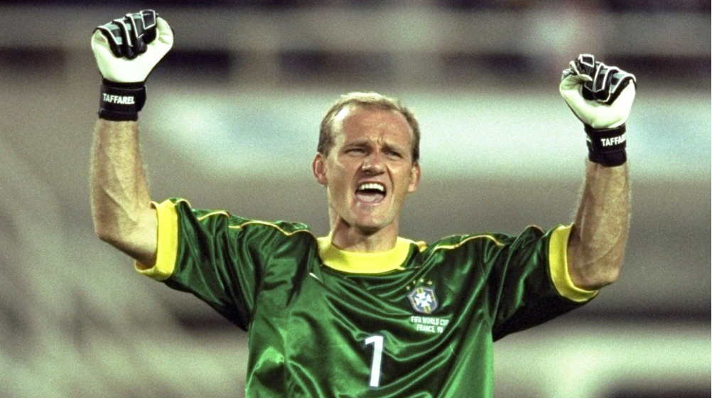

“Penalty kicks don’t necessarily mean the best team came out on top.”
Claudio Taffarel
Former Brazil Goalkeeper
“Penalty shootouts have nothing to do with football.
It’s like shooting poor wee ducks at a fairground.”
Alex Smith
Former Manger of Aberdeen

Slide 3
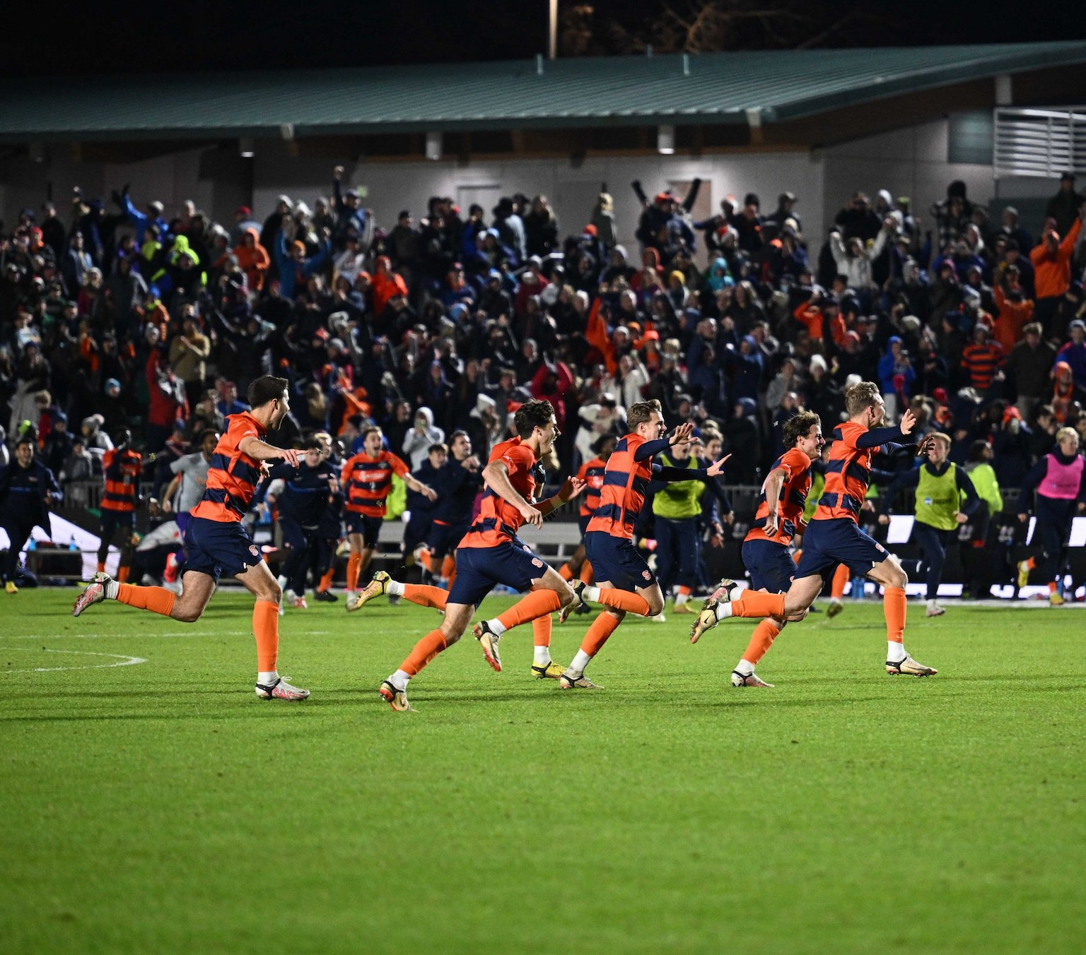
Importance of Penalty Kicks
Since 2020, 24 NCAA D1 Men’s Soccer National Tournament Games ended in a Penalty Shootout
Notably Syracuse Winning the Championship game in 2022 on Penalty Kicks
Since 2020, 29 NCAA D1 Women’s Soccer National Tournament Games ended in a Penalty Shootout
Notably Santa Clara Winning the Championship Game in 2020 on Penalty Kicks

Slide 4

Data Collection
Data was collected through Wyscout
Permissions were given through New College Men’ s Soccer Program
269 Individual Penalty Kicks were collected from NCAA Men’s Soccer Games

Slide 5
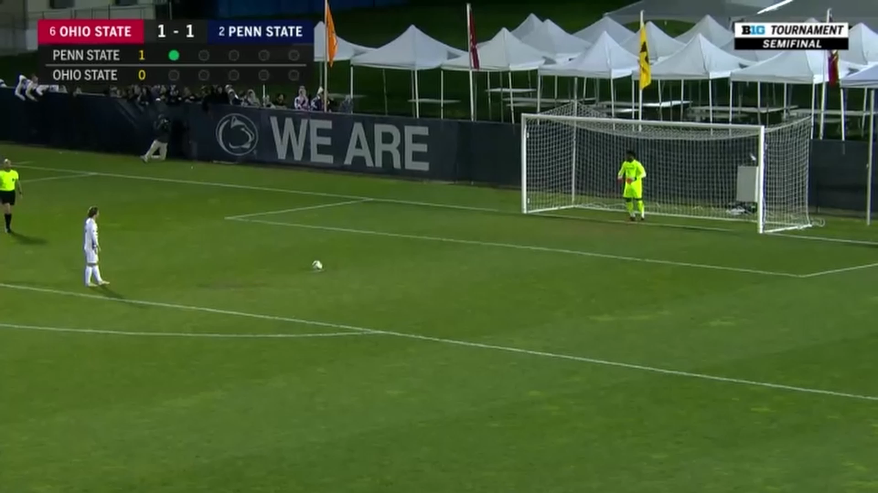
Data Cleaning
Clips were Individual Classified as going “Left”, “Right”, or “Center”
Clips were Cropped to just include the Shooter and trimmed to be just the run-up to the shot
Train, Validation, Test Split
Training – 70% - 188 clips
Validation – 18% - 48 clips
Test – 12% - 33 Clips

Slide 6

MediaPipe – Pose Estimation
Developed by Google
Open-Source Framework Pose Estimation Model
Allows from a 2D image, Estimates of positional landmark position in Image Coordinates and in 3D World Coordinates.

Slide 7
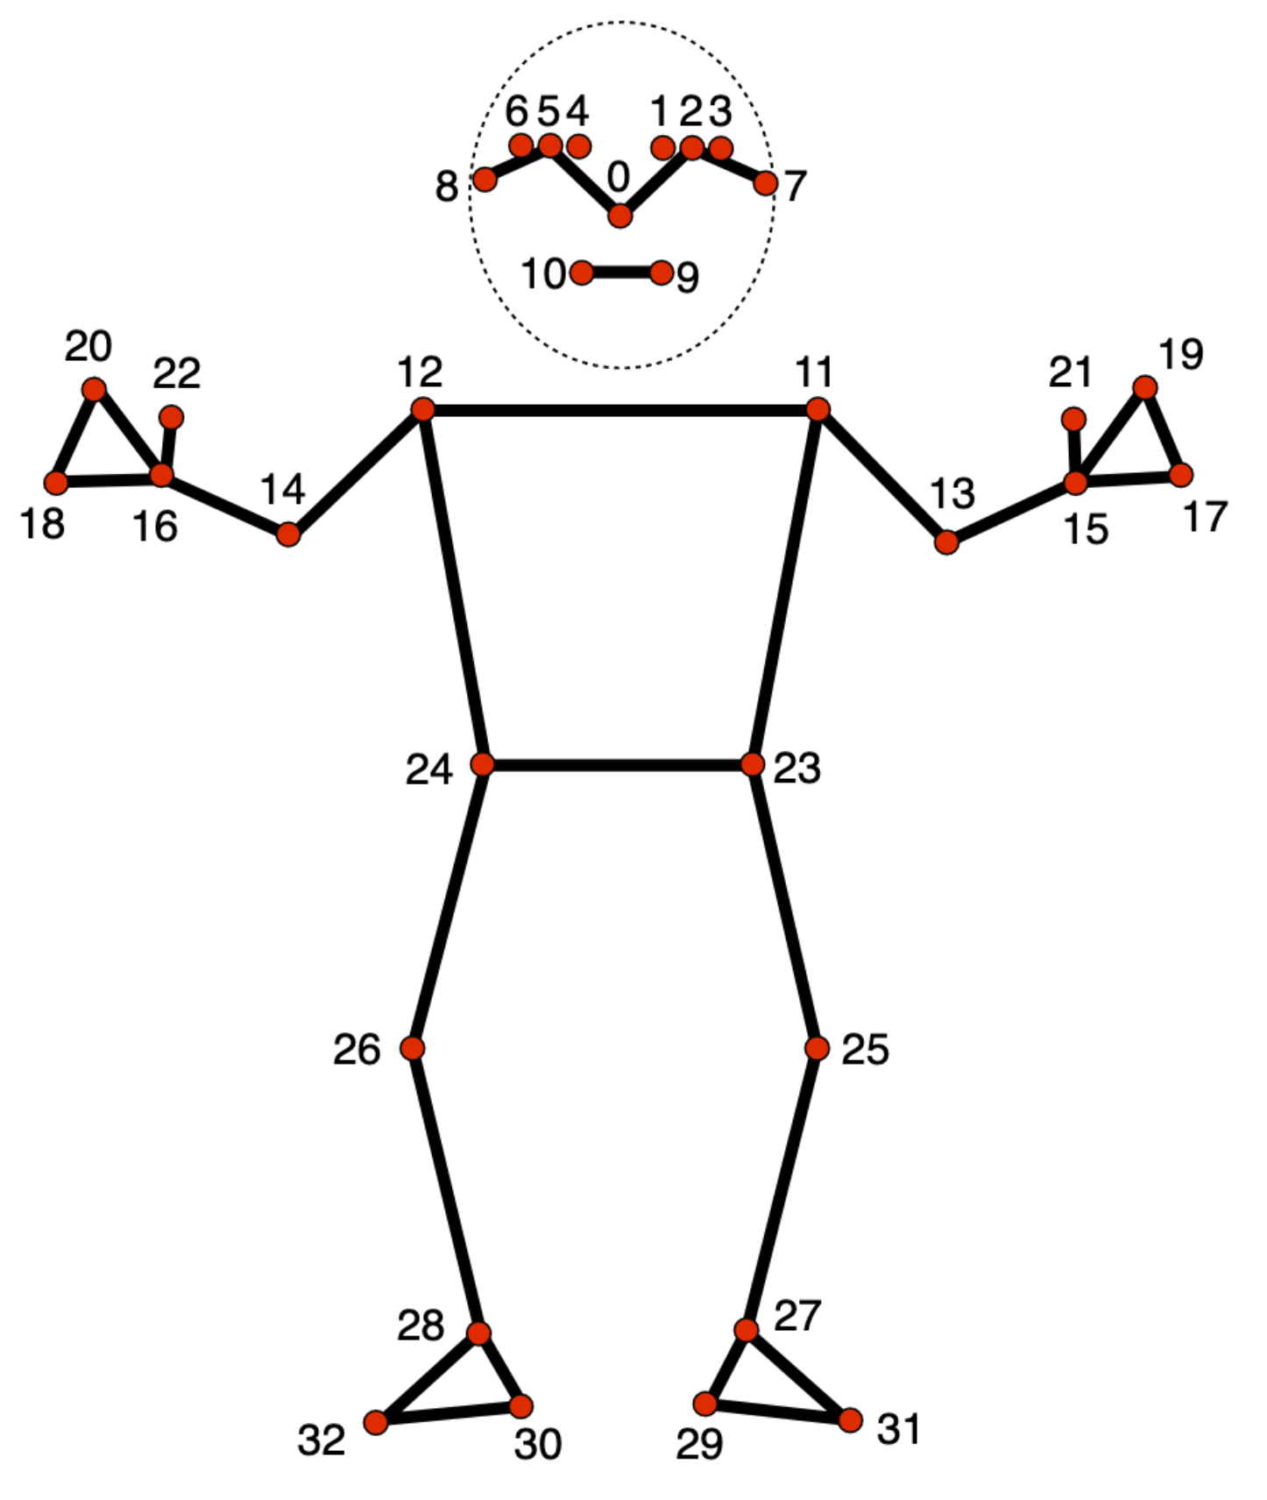
Pose Estimation on Dataset
Training and Validation Sets were Augmented
Horizontal Shifts
Horizontal Flips
Rotation
Contrast, Brightness, Saturation
Ending Sizes
Train – 5411
Validation –
Test -
30 iterations of the Data Augmentations were performed on Each Clip
Removed Points 0-10 from Datasets
Padded End of Clip
Repeating Last seen pose positions

Slide 8
LSTM
Multi-Layer LSTM
Using Tanh and L2 Regularization
Issues with Exploding and Vanishing Gradients.
Dropout of .8 and Batch Normalized
Inputs were Scaled using StandardScaler
Loss: Categorical Cross entropy
SMOTE was used to balance Training Set.

Slide 9

Results

Slide 10
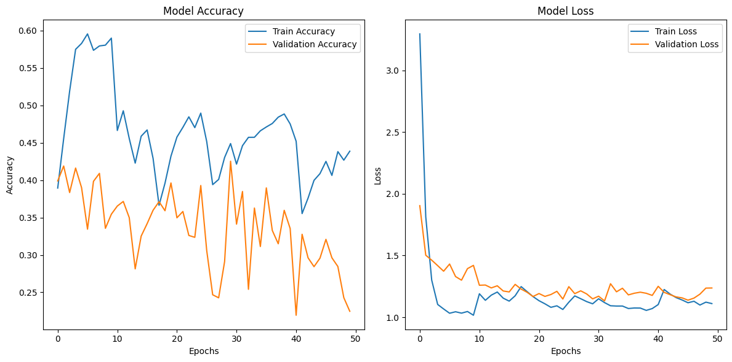
Model Training Graphs – 3 Classes
Theoretical Expected Accuracy = .377
Test Set Accuracy: .39

Slide 11
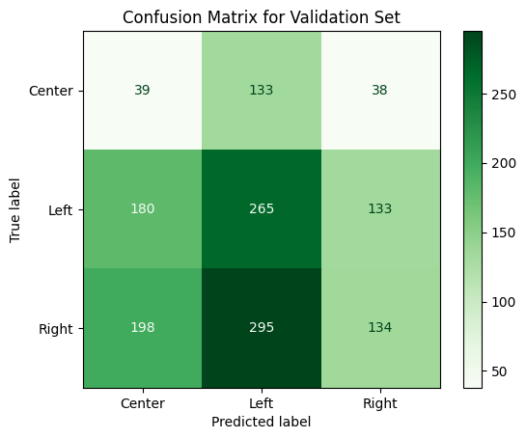
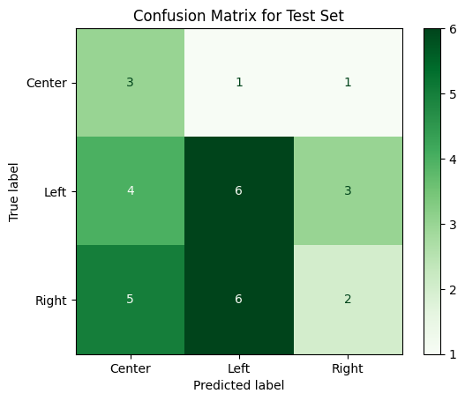
Confusion Matrix

Slide 12
Problem
Poor Accuracy: Model is performing slightly above Random in Accuracy
Padding: Padding the end is causing In accurate results after the clip has concluded
Results are Switching from Correct answers to decreasing in value for that prediction by the end of padding section

Slide 13
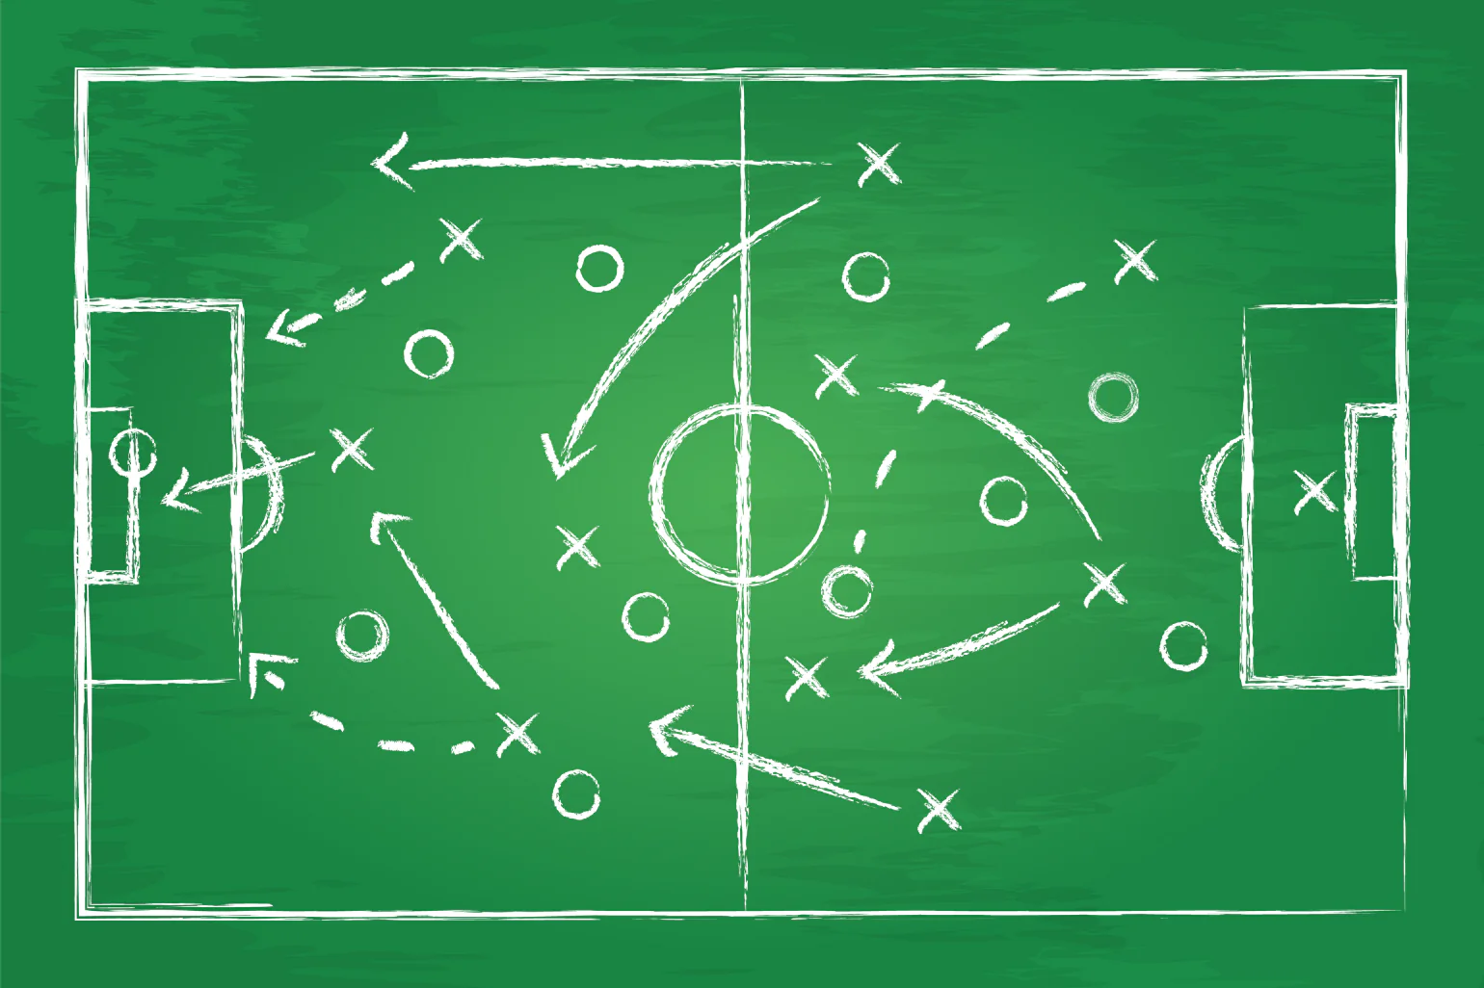

Tactic Change: Invert Padding
Apply padding at the beginning with both just 0’s and the first pose repeated

Slide 14
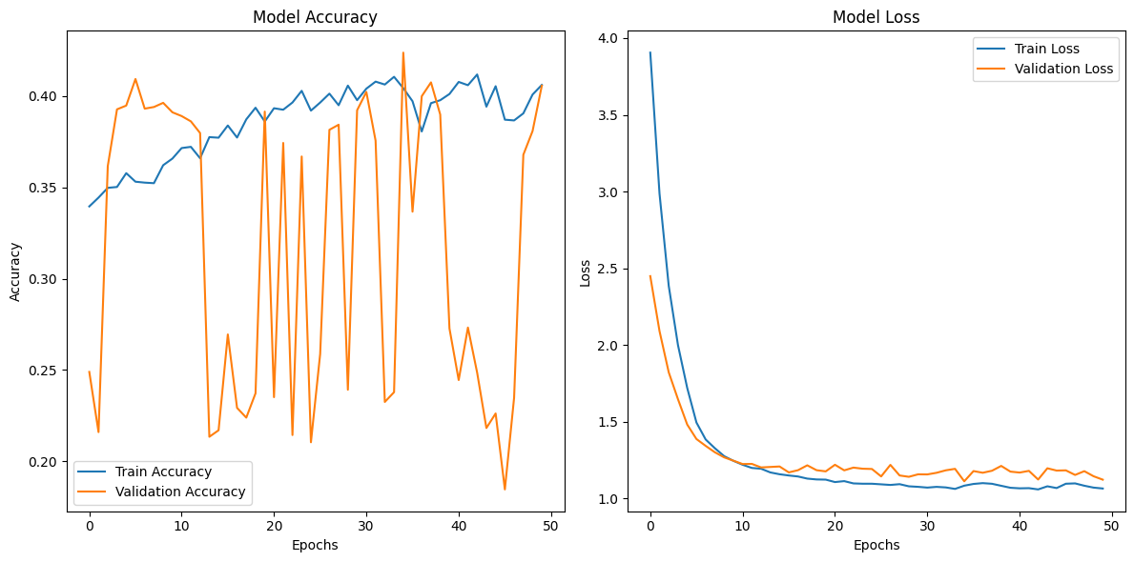
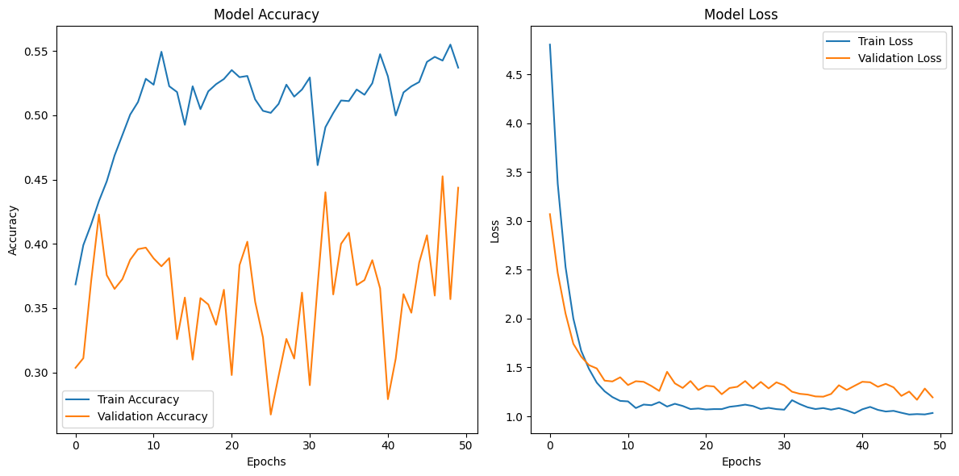
Padded Models
Zero - Padding
50 Epochs
Repeat - Padding

Slide 15
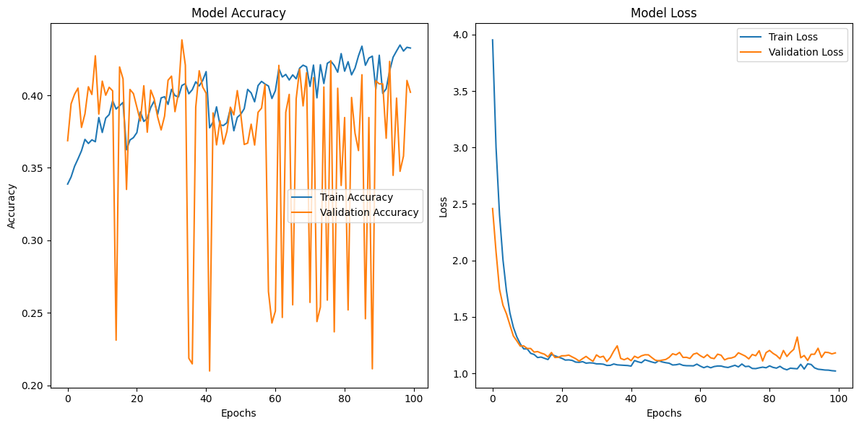
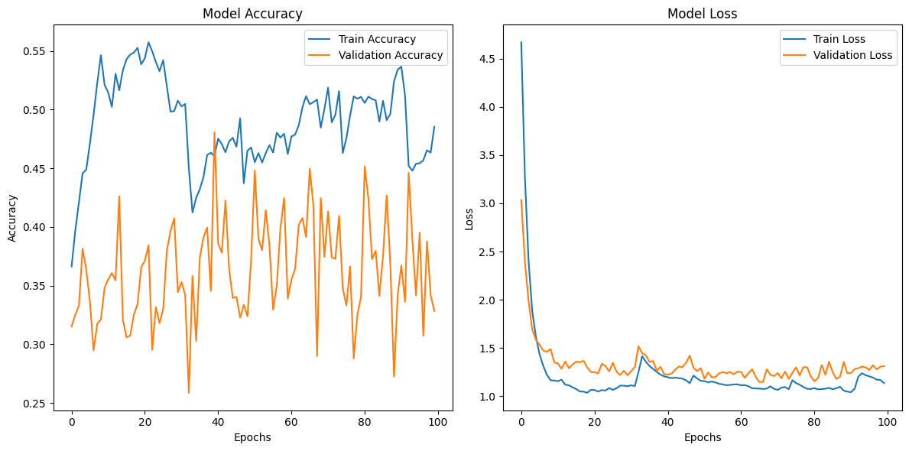
Padded Models
Zero - Padding
100 Epochs
Repeat - Padding

Slide 16

Conclusions

Slide 17
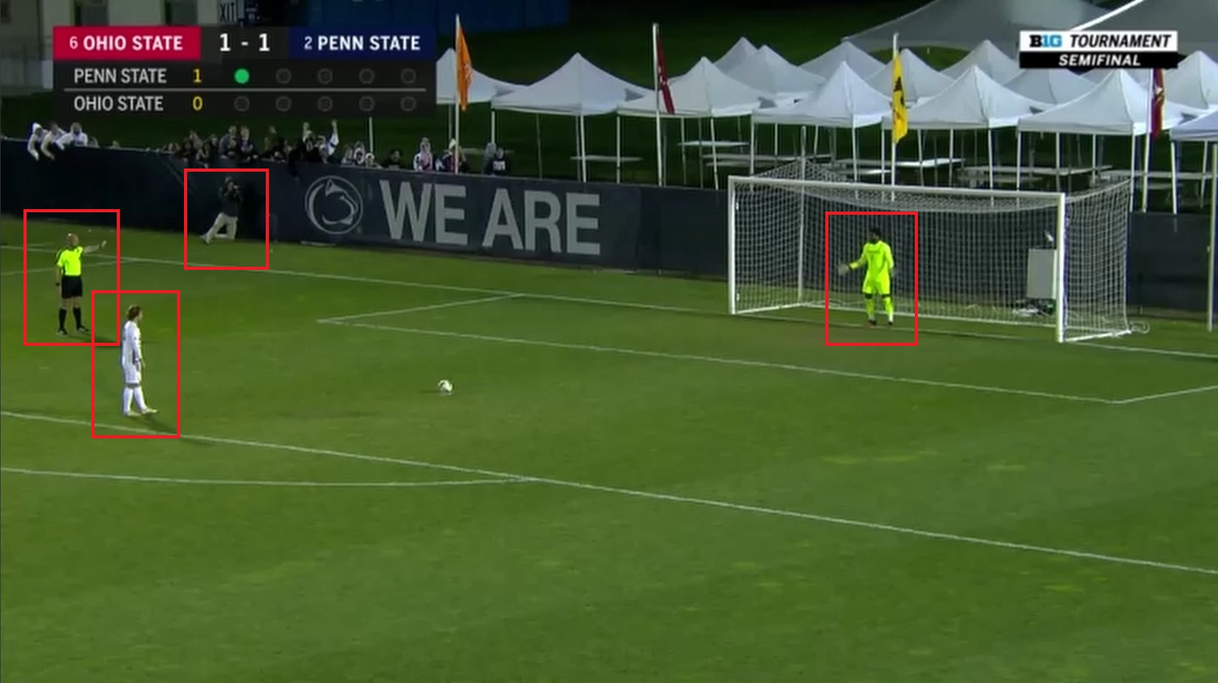
Future Work
Allow for Automation of Data Cropping using Person Detection Algorithms such as YOLO.
Generate Increased Dataset to improve performance and reliance on Data Augmentation
Use 3-Dimensonal Coordinates

Slide 18
Thank you

